Slide 1
Artificial Intelligence
Artificial Intelligence
Machine Learning
Reinforcement Learning
Backtracking
Rule based knowledge items
Training set
Aggregate function
Reward/ Penalty system
The output of the system is self-input
The system evaluates itself

Slide 2
Machine Learning
The ability of computers to learn without being explicitly programmed

Slide 3
Machine Learning
Supervised Learning
Unsupervised Learning
Training data is labelled
Training data is not labelled
Automatic grouping required
Linear Regression
Logistic Regression
Neural Networks
Support Vector Machines
Bayes Theorem
Decision Trees
K-nearest neighbors
K-means clustering
Associative algorithms (eg: Apriori algorithm)

Slide 4
Linear Regression
Sq feet | Price in thousand dollars
100 | 100
200 | 250
300 | 275
y’ = mx + c -------- hypothesis(prediction)
Cost function:
(y - y’)² / n --------- Mean squared error function

Slide 5
Gradient Descent
Repeat until convergence
{
m = m – LR*PartialGradient(Cost Function)
c = c – LR*PartialGradient(Cost Function)
}

Slide 6
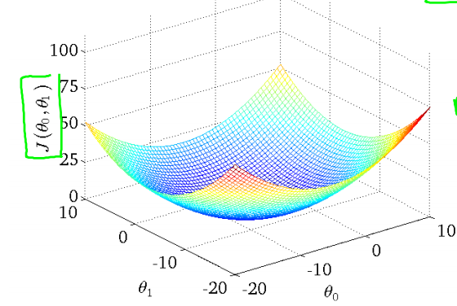
Gradient Descent

Slide 7
Logistic Regression
Tumor Size(units) | Cancerous?
1 | 0
3 | 0
4 | 1
6 | 1
y’ = mx + c ?????
The logistic function
g(z) = 1/(1 + e^{-z})
Where
z = mx + c

Slide 8
Cost function
Log(0) = - infinity
Log(1) = 0
Cost(y’, y)=−log(y’) if y = 1
Cost(y’, y)=−log(1−y’) if y = 0

Slide 9
Simplified cost function
Cost(y’, y) = −y*log(y’) − (1−y)*log(1 − y’)

Slide 10
Neural network
feature1
feature2
feature3
Input layer
Hidden layer
Output layer

Slide 11
Euclidean Distance
X(1,2)
X(2,1)
Distance = sqrt((x1-x2) (x1-x2) + (y1-y2) (y1-y2))
Distance = sqrt((1-2)(1-2) + (2-1)(2-1))
Distance = sqrt(1 + 1) = sqrt(2) = 1.414

Slide 12
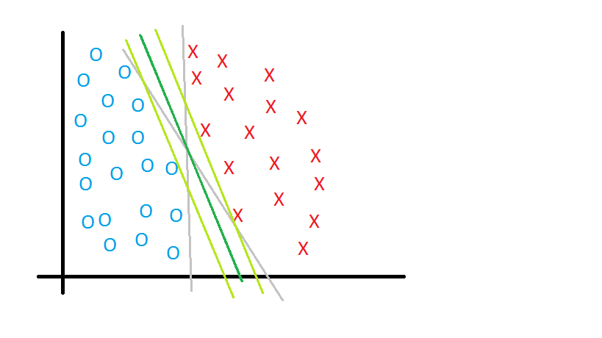
Support Vector Machine
Large margin classifier

Slide 13
o
o
o
o
o
o
o
o
o
o
o
o
o
o
o
o
o
o
o
o
o
o
o
o
o
o
o
o
o
o
o
o
o
o
o
o
o
o
o
o
o
o
o
o
o
o
o
o
X
o
X
X
X
X
o
o
X
X
X
X
X
X
X
X
X
o
X
X
X
X
X
o
o
o
X
X
X
X
X
o
o
o
o
X
o
o
o
X
X
X
X
X
X
o
o
o
o
X
X
X
o
o
o
o
o
X
o
o
o
o
o
o
o
o
o
o
o
o
o
o
o
o
o
o
o
o
o
o
o
o
o
o
o
o
o
o
o
o
o
o
o
o
o
o
o
o
o
o
o
o
o
o
o
o
o

Slide 14

Kernels
Linear kernel : if m1x1 + m2x2 + m3x3 + … >= 0 predict y’ = 1 otherwise 0
Gaussian kernel: Aka Radial Basis Function(RBF)

Slide 15
Naïve Baye’s Algorithm
Maximize,
X = (age = youth, income = medium, student = yes, credit rating = fair)

Slide 16
Calculations
P(buys computer = yes) = 9/14 = 0.643
P(buys computer = no) = 5/14 = 0.357
P(age = youth | buys computer = yes) = 2/9 = 0.222
P(age = youth | buys computer = no) = 3/5 = 0.600
P(income = medium | buys computer = yes) = 4/9 = 0.444
P(income = medium | buys computer = no) = 2/5 = 0.400
P(student = yes | buys computer = yes) = 6/9 = 0.667

Slide 17
Contd..
P(student = yes | buys computer = no) = 1/5 = 0.200
P(credit rating = fair | buys computer = yes) = 6/9 = 0.667
P(credit rating = fair | buys computer = no) = 2/5 = 0.400

Slide 18
Contd…
Using these probabilities, we obtain
P(X|buys computer = yes) = P(age = youth | buys computer = yes) * P(income = medium | buys computer = yes) * P(student = yes | buys computer = yes) * P(credit rating = fair | buys computer = yes) = 0.222*0.444*0.667*0.667 = 0.044.
Similarly,
P(X|buys computer = no) = 0.600*0.400*0.200*0.400 = 0.019.

Slide 19
Contd…
To find the class, Ci , that maximizes P(X|Ci)P(Ci), we compute
P(X|buys computer = yes)*P(buys computer = yes) = 0.044*0.643 = 0.028
P(X|buys computer = no)*P(buys computer = no) = 0.019*0.357 = 0.007

Slide 20
K means clustering
2, 3, 4, 5, 6, 7

Slide 21
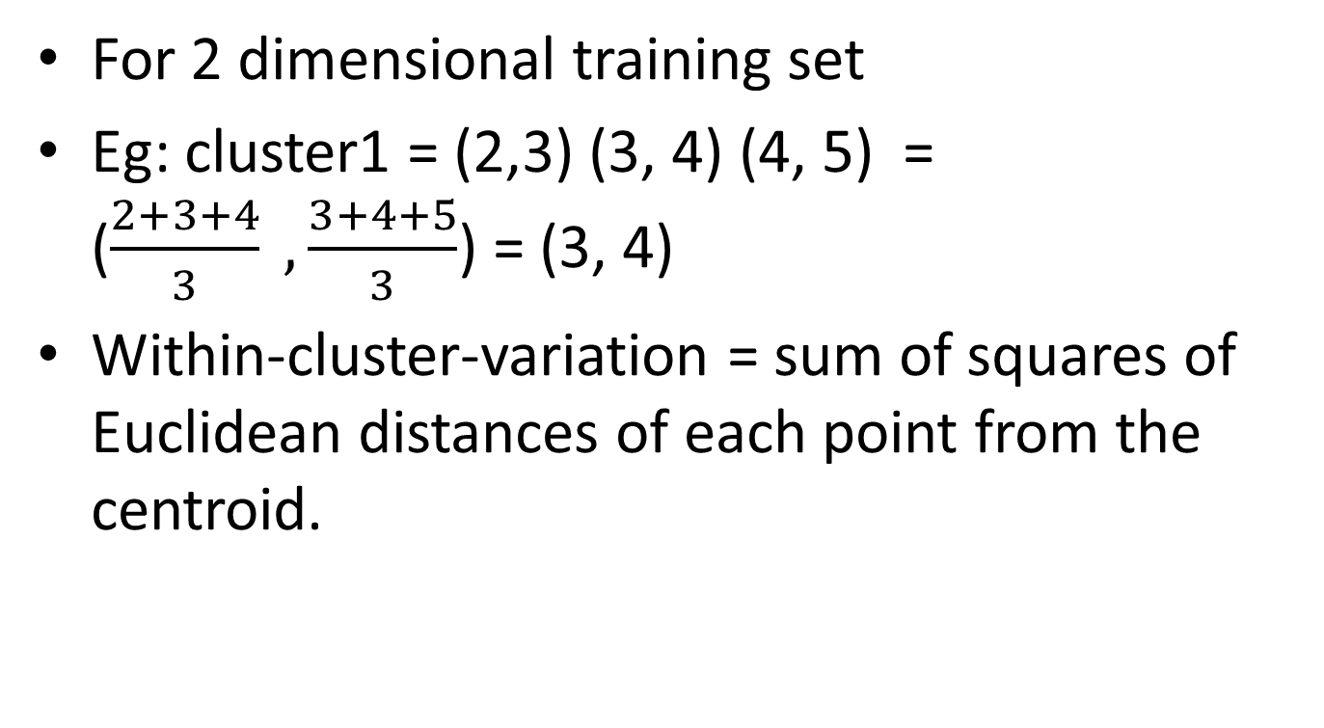
K means clustering
For 2 dimensional training set
Eg: cluster1 = (2,3) (3, 4) (4, 5) = ($\frac{2+3+4}{3} ,\frac{3+4+5}{3}$) = (3, 4)
Within-cluster-variation = sum of squares of Euclidean distances of each point from the centroid.

